Slide 1
Lecture 3 – Linear Regression
Yanwen Wang
Sauder School of Business
University of British Columbia
Feb-March 2018

Slide 2

Linear Regression Model
Terminology
$Y_{i}$: dependent variable
$X_{i1},…,X_{ik}$: independent variable
$β_{0}$: intercept
$β_{1}, …, β_{k}$: slopes
$ε_{i}$: residuals(error terms)
$$Y_{i}=β_{0}+β_{1}X_{i1}+β_{2}X_{i2}+ ….+β_{k}X_{ik}+ε_{i}$$

Slide 3
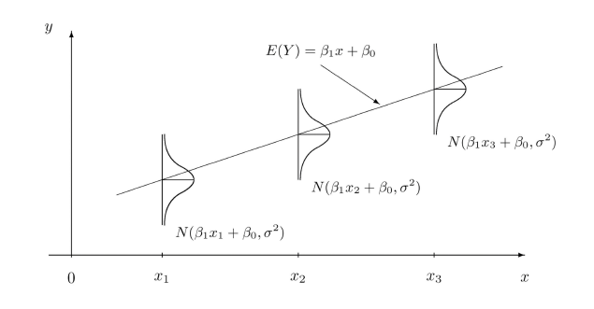
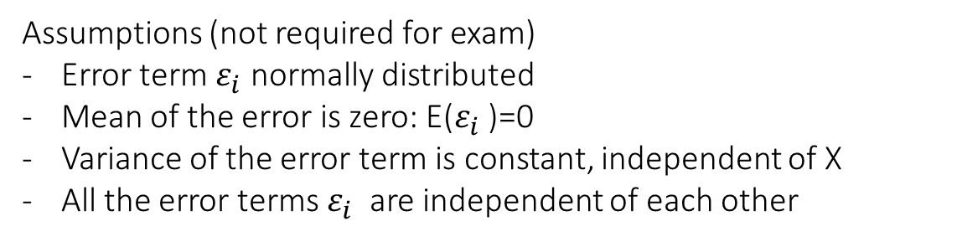

Assumptions of Linear Regression Model
Assumptions (not required for exam)
Error term $ε_{i}$ normally distributed
Mean of the error is zero: E($ε_{i}$ )=0
Variance of the error term is constant, independent of X
All the error terms $ε_{i}$ are independent of each other
Conditional mean model $E\left(Y | X\right)=β_{0}+β_{1}x$

Slide 4
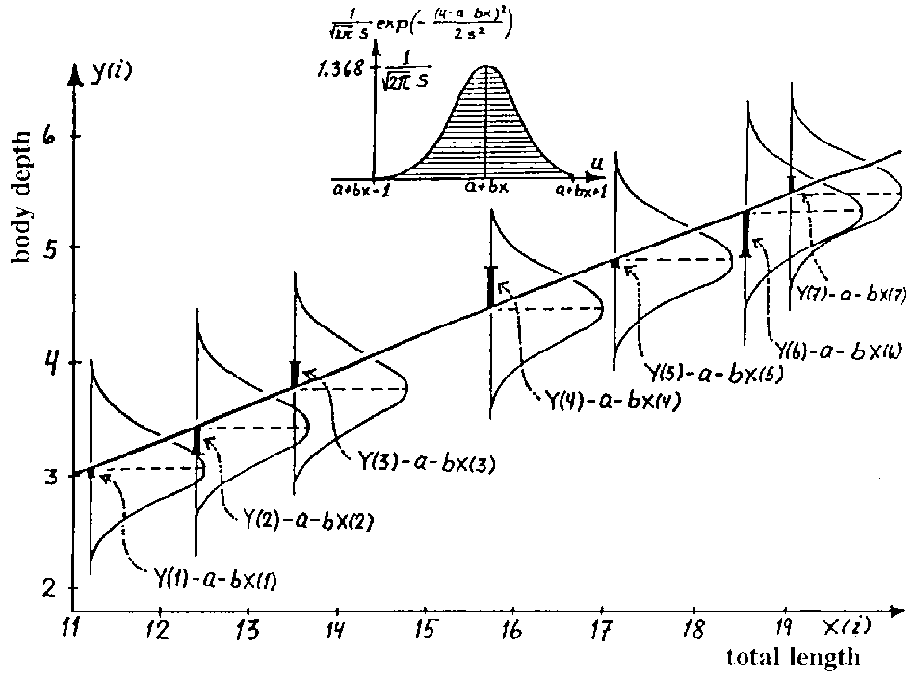
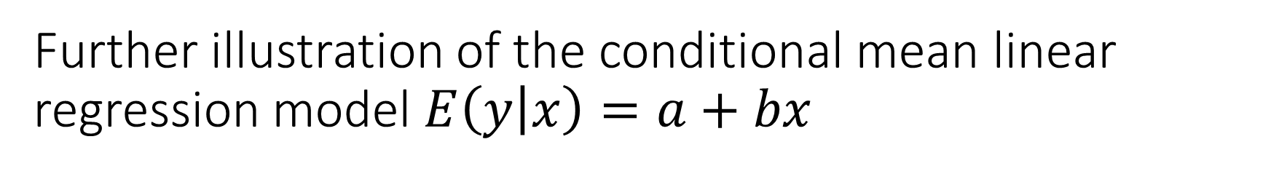
Further illustration of the conditional mean linear regression model $E\left(y | x\right)=a+bx$

Slide 5
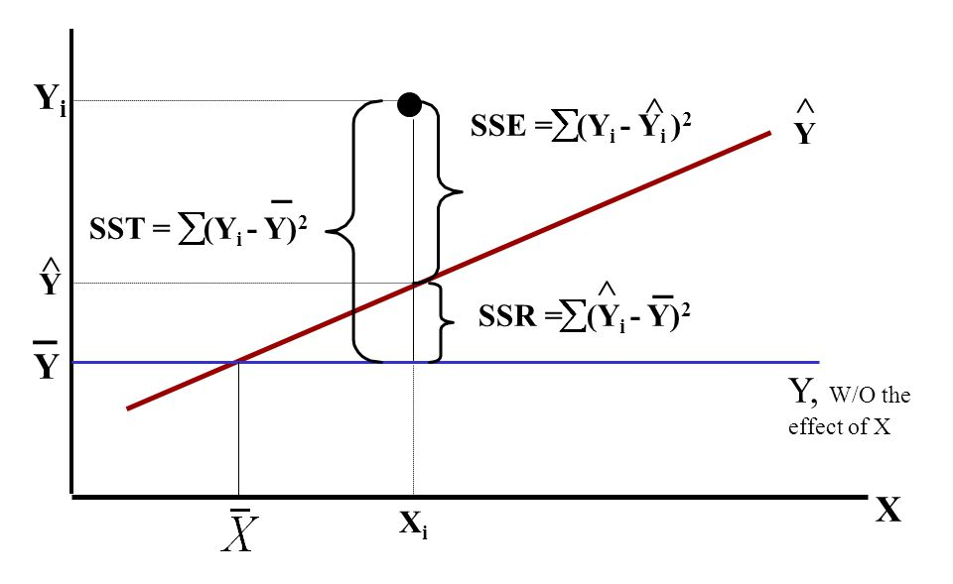
Decomposition of Variance

Slide 6
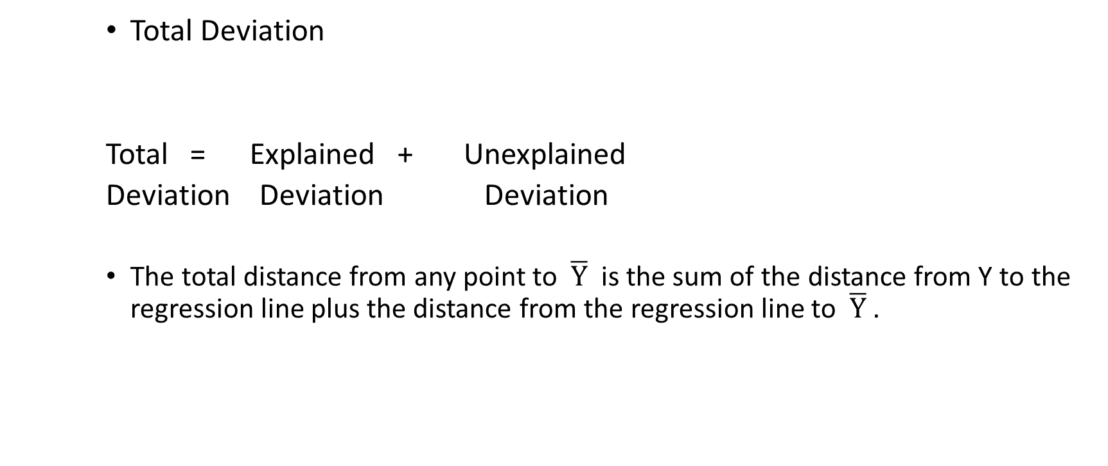
Decomposition of Variance I
Total Deviation
Total = Explained + Unexplained
Deviation Deviation Deviation
The total distance from any point to $\overline{Y}$ is the sum of the distance from Y to the regression line plus the distance from the regression line to $\overline{Y}$ .

Slide 7
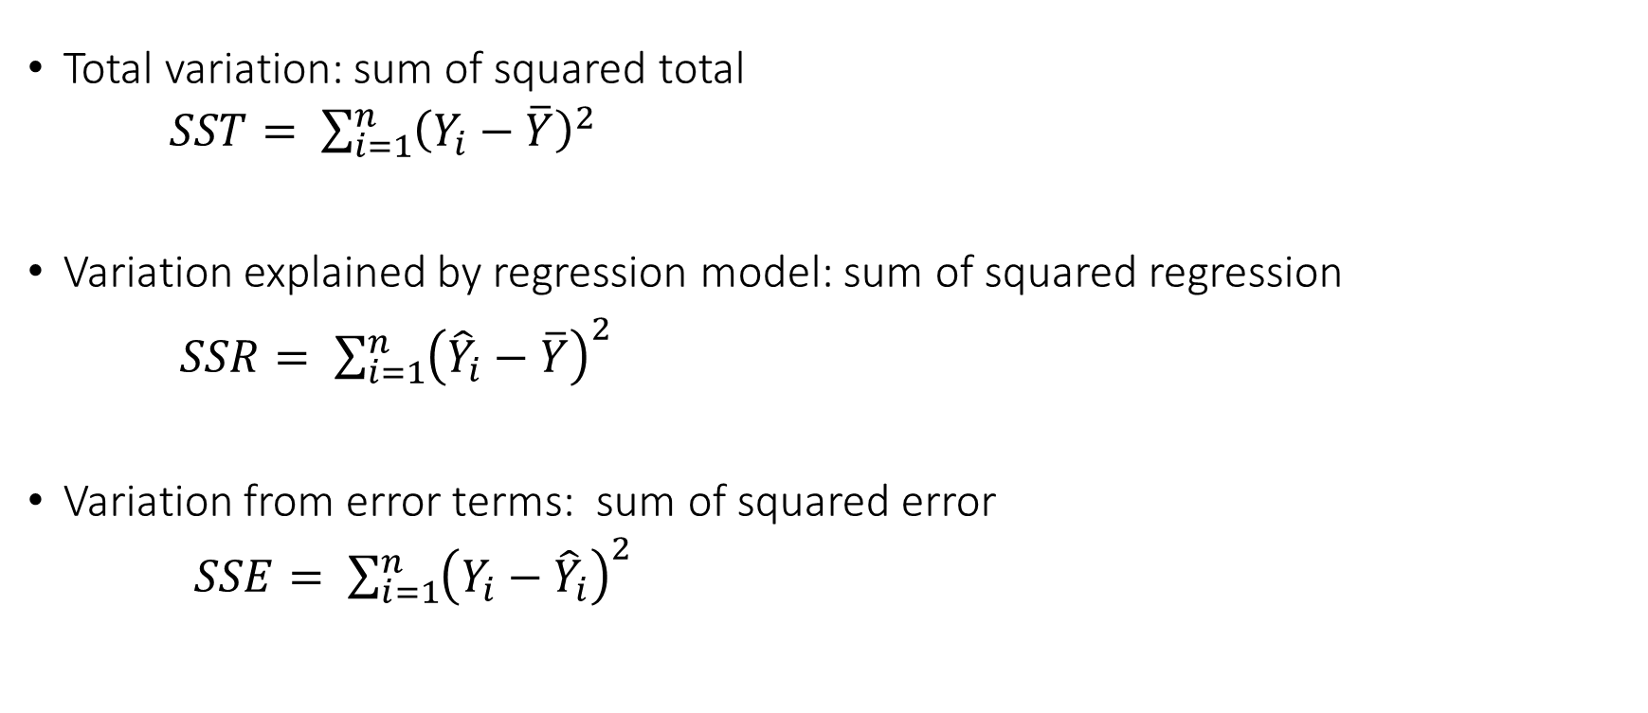
Decomposition of Variance II
Total variation: sum of squared total
$SST= \sum_{i=1}^{n}{{\left(Y_{i}−\overline{Y}\right)}^{2}}$
Variation explained by regression model: sum of squared regression
$SSR= \sum_{i=1}^{n}{{\left({\hat{Y}}_{i}−\overline{Y}\right)}^{2}}$
Variation from error terms: sum of squared error
$SSE= \sum_{i=1}^{n}{{\left(Y_{i}−{\hat{Y}}_{i}\right)}^{2}}$

Slide 8
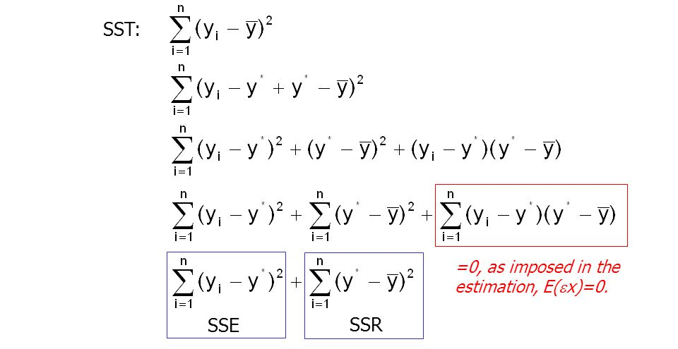
SST = SSR + SSE

Slide 9

Mean Squared Error = MSE
Variability in Y not accounted for by your model per remaining parameter
i.e., MSE = SSR / (n – p – 1), with n = # observations, and p = # additional parameters
Residual Standard Error = RSE
Square root of variability in Y not accounted for by your model per remaining parameter
$RSE=\sqrt{MSE}$

Slide 10
In-class Exercise of Linear Regression
Download baseball.csv
Let’s run a regression model of attendance on weekday and tickets_sold

Slide 11
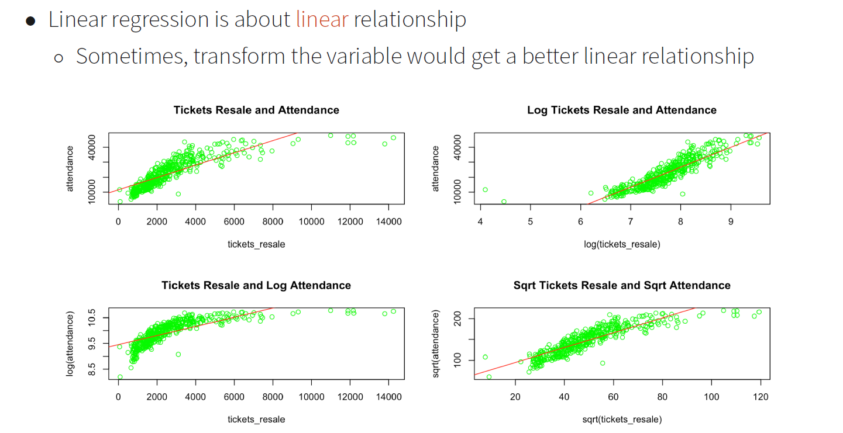
Variable Transformation and Linear Regression

Slide 12
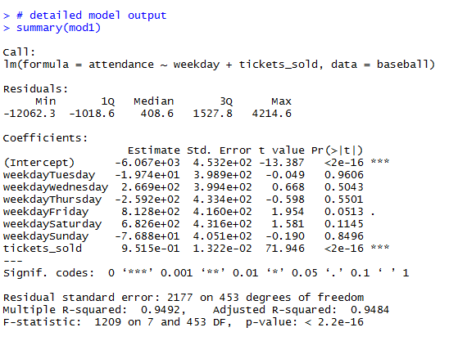
Estimation Results

Slide 13
How Good is Our Model?
R-squared
Adjusted R-squared
F statistics

Slide 14
Degrees of freedom = DF
Number of remaining parameters
i.e., number of observations minus the number of parameters in your model
Examples:
For a model with only an intercept: n – 1
For a model with an intercept and a slope: n – 2
For a model with an intercept and two slopes: n – 3

Slide 15
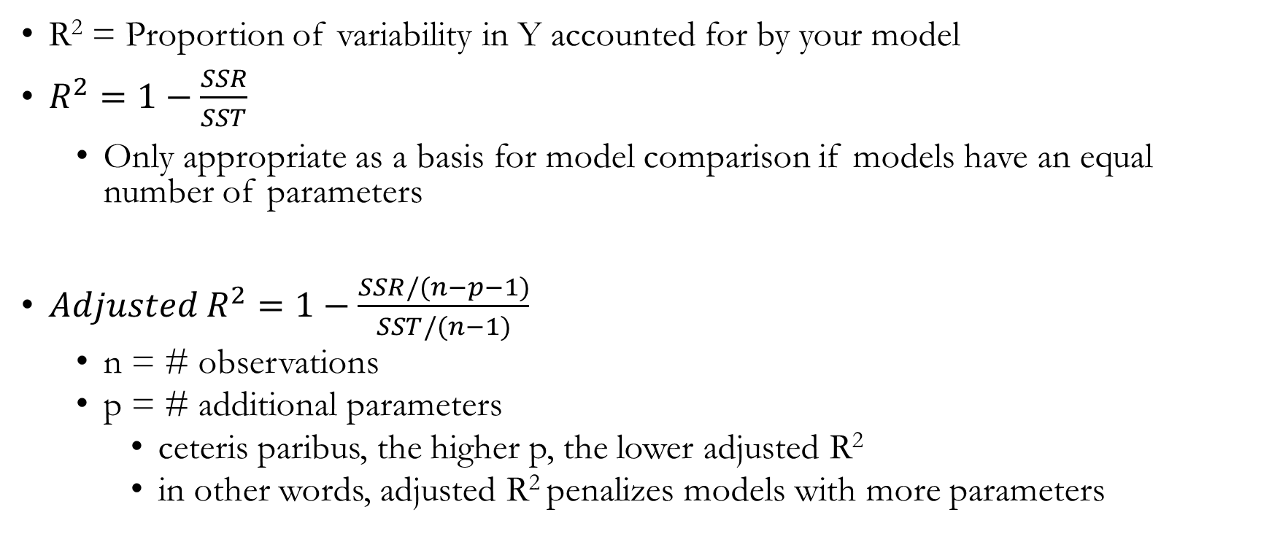
R-squared and adjusted R-squared
R² = Proportion of variability in Y accounted for by your model
$R^{2}=1−\frac{SSR}{SST}$
Only appropriate as a basis for model comparison if models have an equal number of parameters
${Adjusted R}^{2}=1−\frac{SSR/(n−p−1)}{SST/(n−1)}$
n = # observations
p = # additional parameters
ceteris paribus, the higher p, the lower adjusted R²
in other words, adjusted R² penalizes models with more parameters
Notes:
why n-1 in denominator? reference model uses one parameter, the intercept
why n-p-1 in the numerator? model uses p parameters

Slide 16
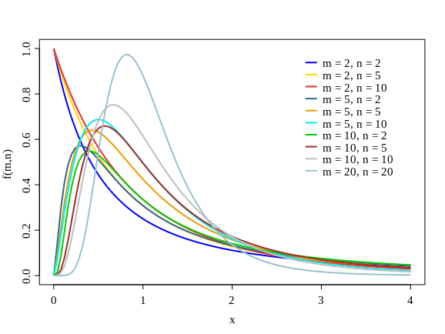
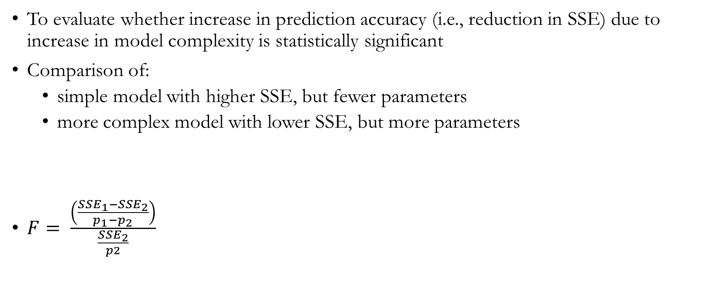
F-statistic
To evaluate whether increase in prediction accuracy (i.e., reduction in SSE) due to increase in model complexity is statistically significant
Comparison of:
simple model with higher SSE, but fewer parameters
more complex model with lower SSE, but more parameters
$F= \frac{\left(\frac{{SSE}_{1}−{SSE}_{2}}{p_{1}−p_{2}}\right)}{\frac{{SSE}_{2}}{p2}}$
Numerator = How much variance were you able to explain by increasing model complexity?
Denominator = How much variance is there left to be explained per remaining parameter?
This ratio should (typically) be higher than 3.84 in order to be statistically significant (i.e., p < .05)

Slide 17
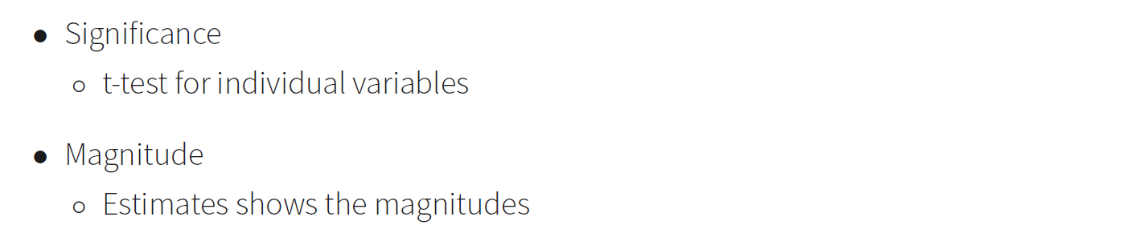
How to Interpret Model Estimates?

Slide 18
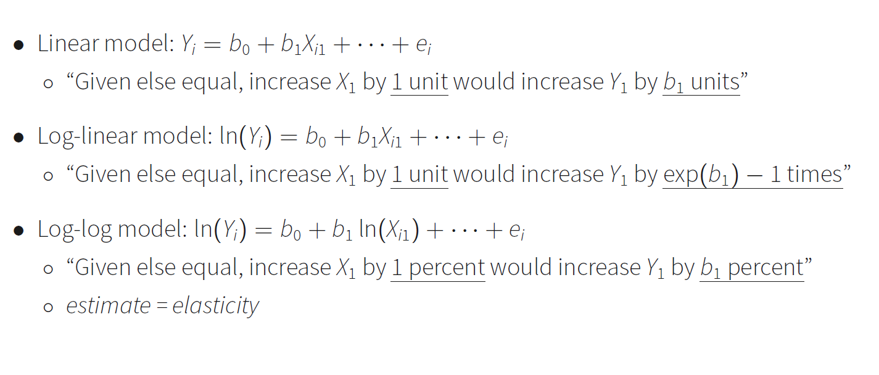
Model Estimates Interpretation
b1 percent

Slide 19
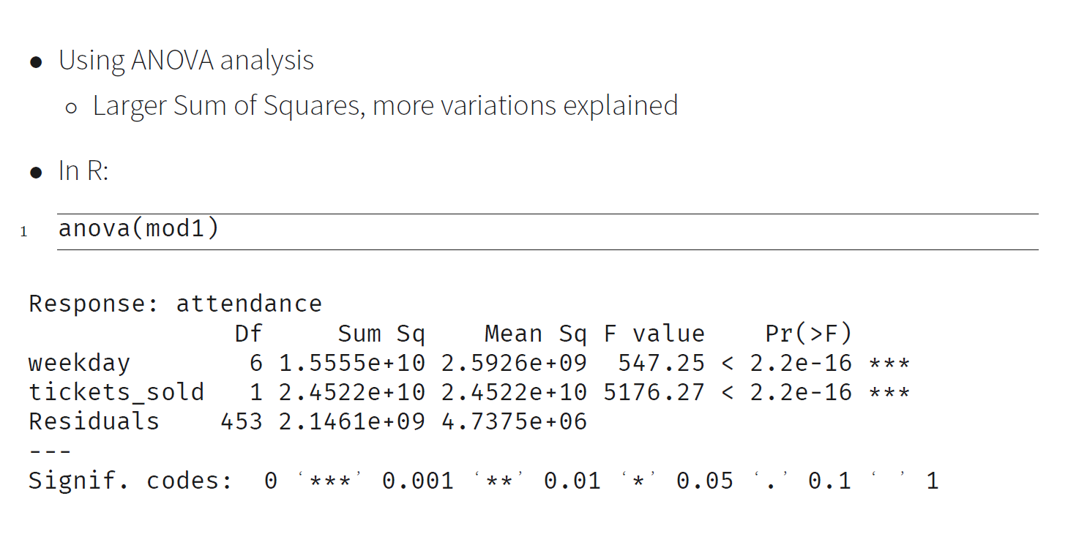
What are the most important components?

Slide 20
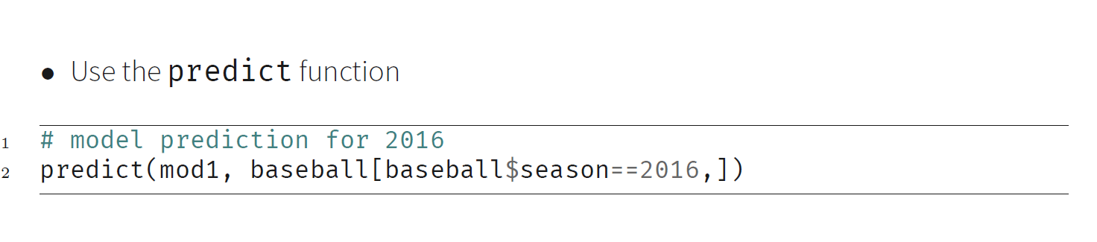
Model Prediction

Slide 21
What is a good regression model?
Managerially meaningful (very important)
Statistically significant
Reasonable model fit: R-squared
Model simplicity
A model with 100 variables may not be a good model
Model calibration vs. model validation
It is important for a model to explain the past
It is also important for a model to predict the future

Slide 22
Continuous vs. categorical variables
number of parameters!
recoding categorical variable with dummy variables
data$categorical.var <- factor(data$continuous.var)
to recode continuous variable as categorical variable

Slide 23
Treatment of missing data I
Casewise deletion
data[complete.cases(data),]
Discard observation if any one of the variables in the observation is missing
Undesirable if entire sample size is small and when each observation has a lot of variables
Biased results if characteristics of discarded observations are different from those of the remaining observations
Notes:
See Blattberg et al. page 301-308

Slide 24
Treatment of missing data II
Single imputation
ifelse(is.na(variable),mean(variable,na.rm=T),variable)
Simplest form is mean substitution, but can also use patterns in the non-missing data to impute a suitable value for the missing response (e.g., using regression)
Ignores uncertainty on the predictions of the unknown missing values
library(zoo)
na.approx interpolation is used to replace the missing values
Notes:
See Blattberg et al. page 301-308

Slide 25
Treatment of missing data III
Missing variable dummies
create a missing variable dummy to signify that the variable is missing for a given customer
For example:
MISS_{i} = 1 if income is missing for customer i, and 0 if not missing
INCOME_NEW_{i} = customer has income if income is not missing, and 0 if missing
Y_{i} = dependent variable to be predicted for customer i, e.g., profit
The model is then: Y_{i} = β₀ + β₁MISS_{i} + β₂INCOME_NEW_{i} + ε_{i}
Ŷ_{i} = β₀ + β₁, if income is missing for customer i
Ŷ_{i} = β₀ + β₂, if income is not missing for customer i
This technique can also be used after single or multiple imputation. The extra dummy takes on the value of 1 if the observation is imputed and 0 if the observation is complete. If the imputation procedure is unbiased, the coefficient associated with the dummy variable will be estimated to be 0. If the coefficient is not zero, the imputation method does not capture the pattern of missing data appropriately.

